Slide 1
Code Sample and Github Link

Slide 2
GitHub Link
Here is the github link of the project
Front-end - https://github.com/StayMatch/staymatch-frontend
Back-end - https://github.com/StayMatch/staymatch-backend

Slide 3
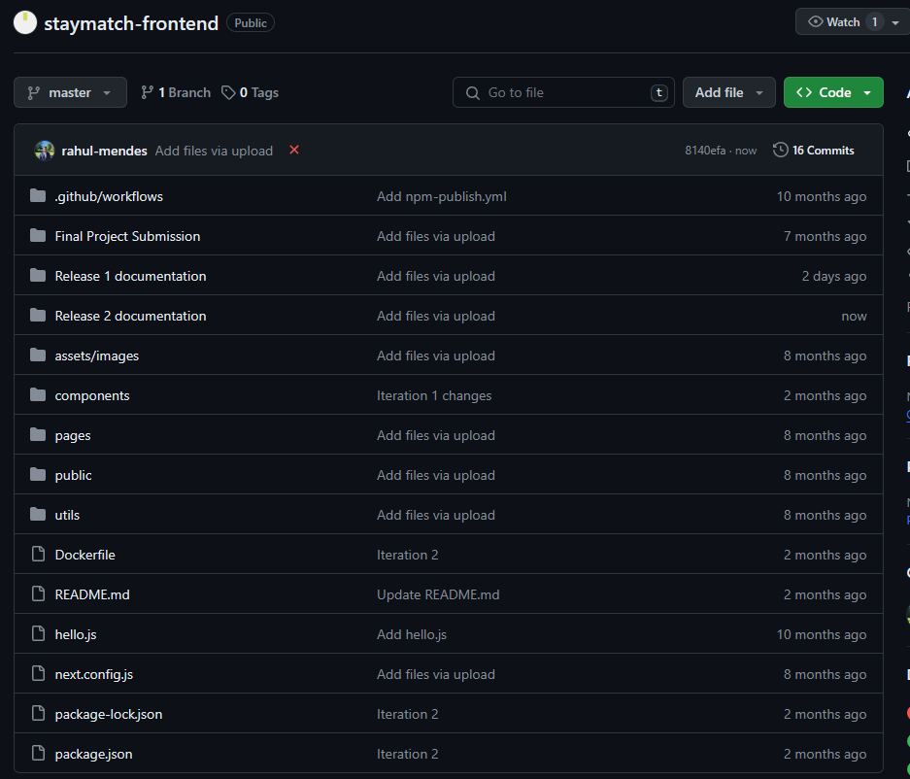
Staymatch front-end repository structure

Slide 4
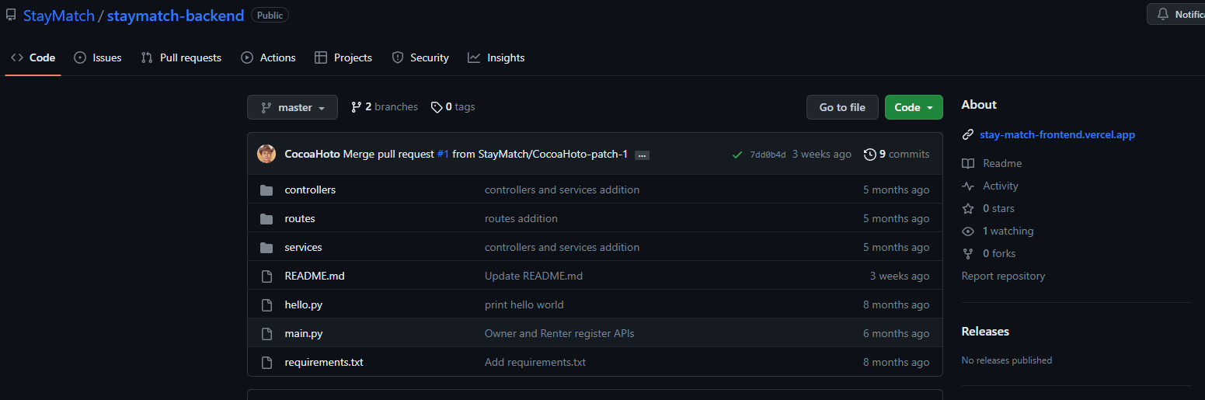
Staymatch back-end repository structure

Slide 5
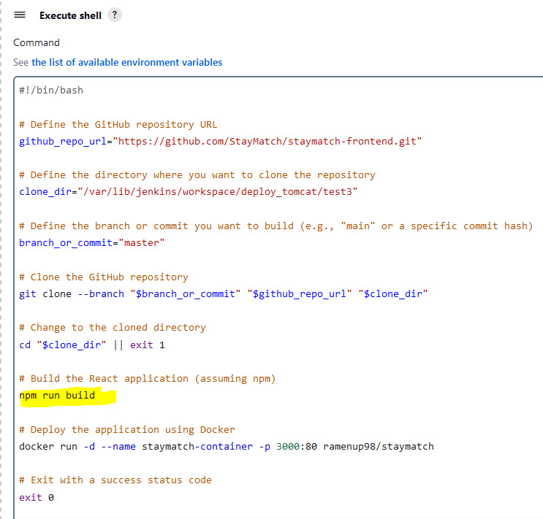
Build and deployment procedure
Node.js, React.js, Docker must be installed on the EC2 instances.
Clone this github repository to the required directory in the EC2 instance.
Build the react application using “npm run build”.
Deploy the application on the docker container after creating it.
The commands for building and deploying used in Jenkins job (shell script) are shown on the right.

Slide 6
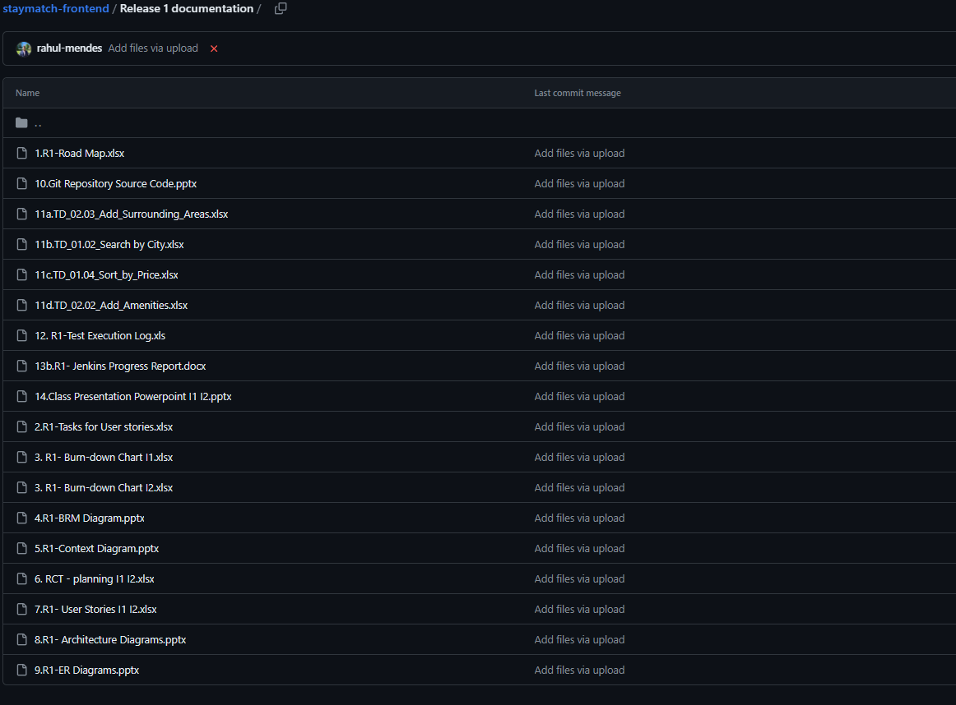
R1 release documentation

Slide 7
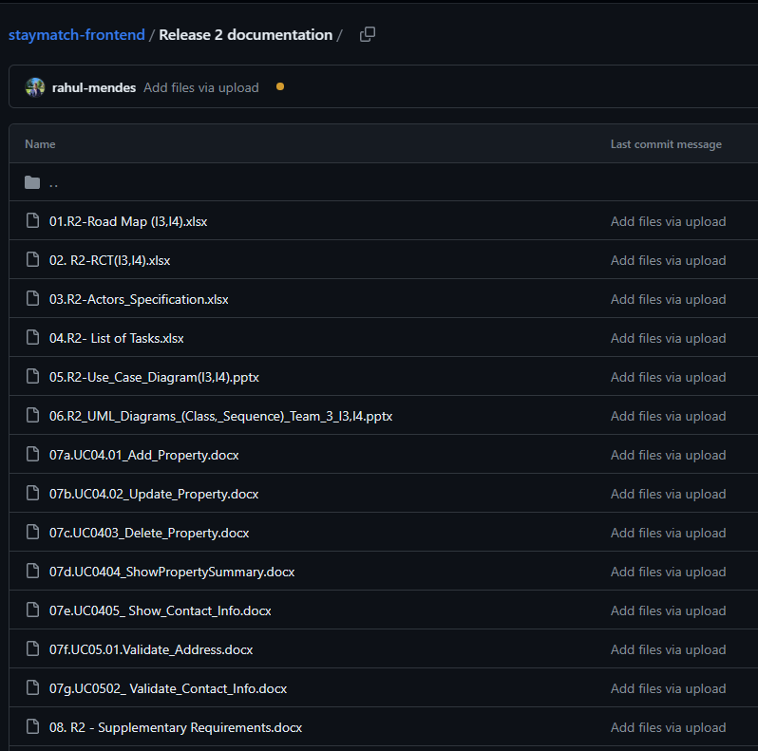
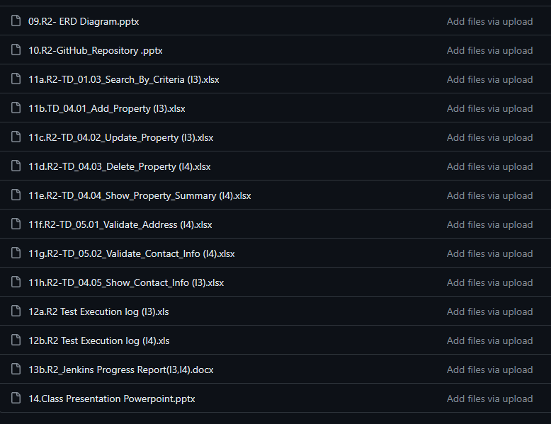
R2 release documentation

Slide 8
R1 – I1 Features
Sort
Search
R1 – I2 Features
Show Property Details
Show Property Amenities

Slide 9
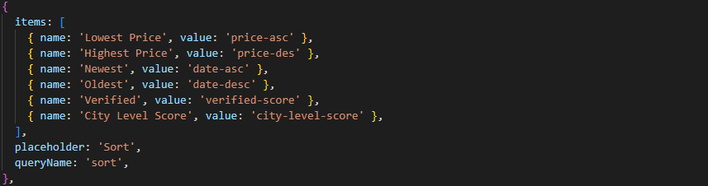
Feature: Sort by Price

Slide 10
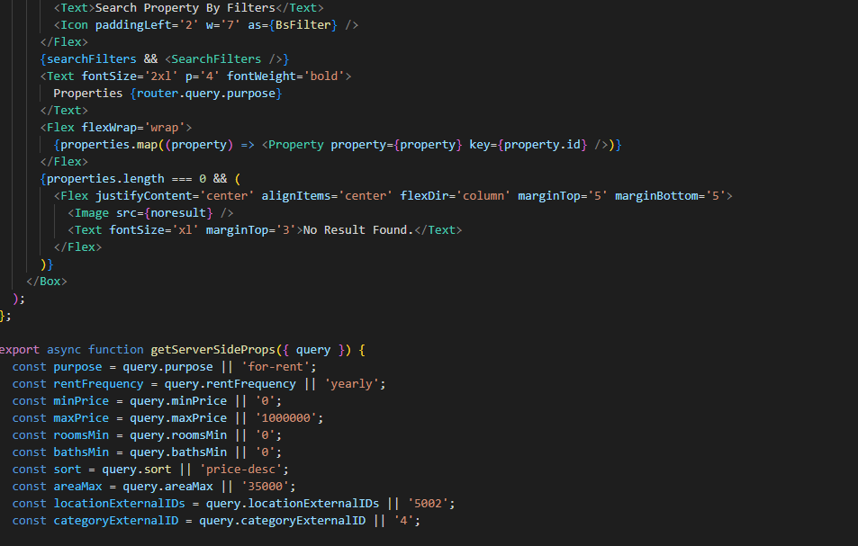
Feature: Search by zip

Slide 11
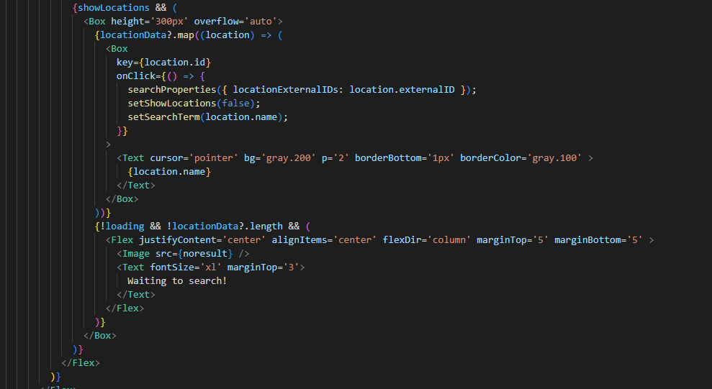
Feature: Search by city

Slide 12
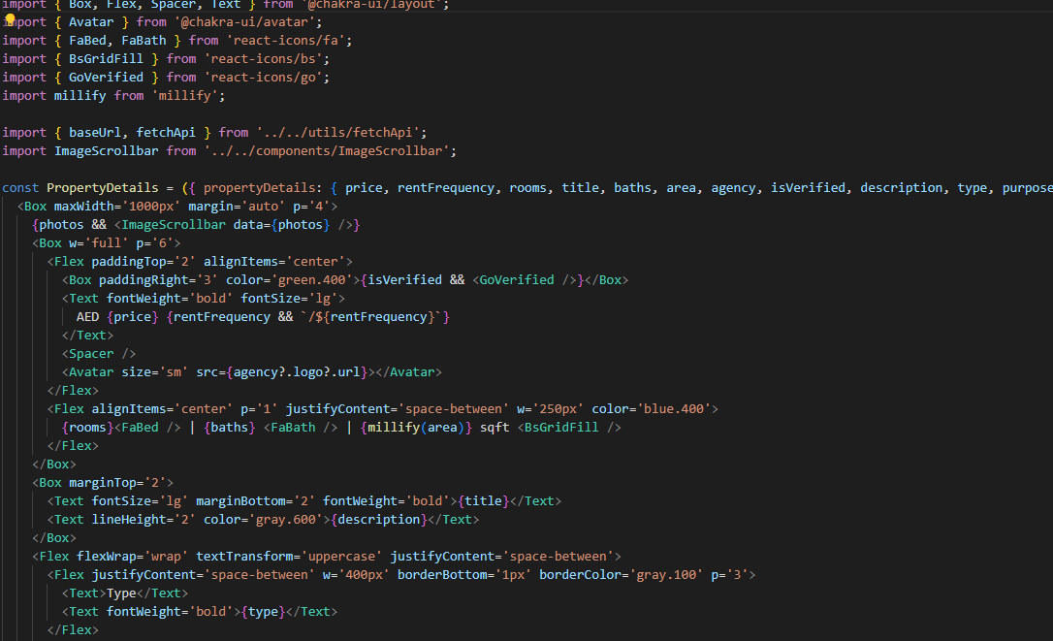
Feature: Show Property Details

Slide 13
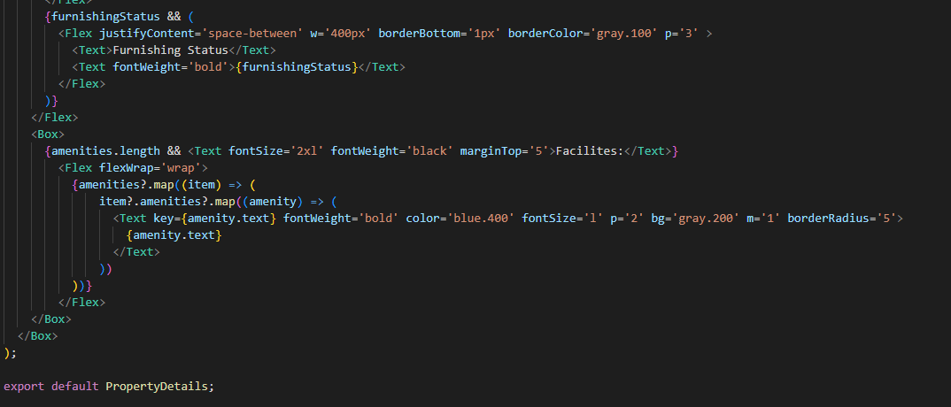
Feature: Show Property Amenities

Slide 14
R2 – I3 Features
Search By Criteria
Show Contact Information
R2 – I4 Features
Validate Address
Show Property Summary

Slide 15
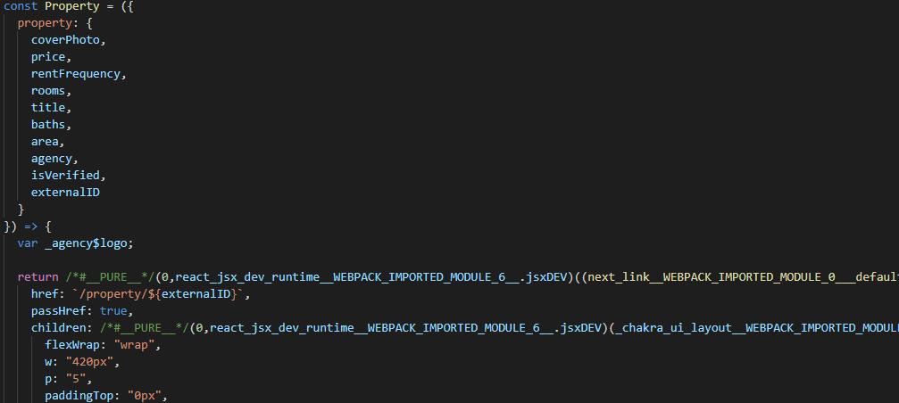
Feature: Show Contact Information

Slide 16
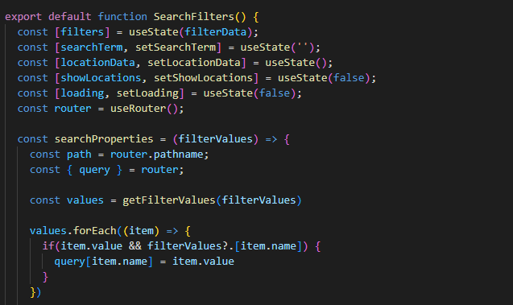
Feature: Search By Criteria

Slide 17
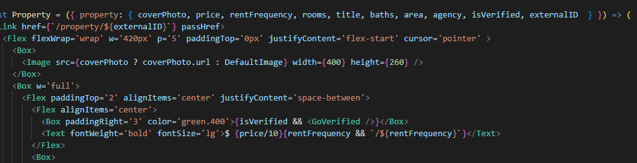
Feature: Validate Address

Slide 18
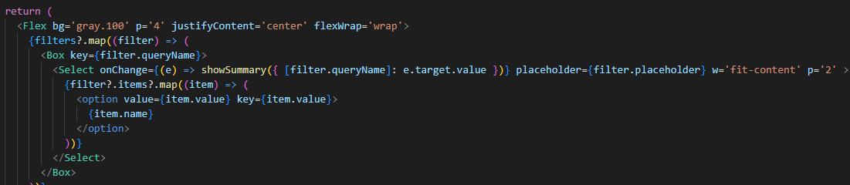
Feature: Show Property Summary

